Slide 1

CMSC 137
Data Communications and Networking
Lecture Module
04 – OSI Model

Slide 2
Module 4: OSI Reference Model
Rozano S. Maniaol
Lecturer

Slide 3
Recall
Network is a combination of hardware and software that sends data from one location to another
Hardware consists of physical equipment that carries signals
Software consists of instruction sets that make possible the services that we expect from a network
There are different companies that produce networking equipment

Slide 4
OSI Reference Model
International Standards Organization (ISO) introduced the Open Systems Interconnection model in the late 1970s
OSI model ISO/IEC 7498-1
Open system – a set of protocols that allows any two different systems to communicate regardless of the underlying architecture
OSI is not a protocol; it is model for understanding and designing a network architecture that is flexible, robust, and interoperable
Layered framework for the design of network systems that allow communication between all types of computer systems

Slide 5
7 Layers

Slide 6
7 Layers of the OSI Reference Model
Layer 7
Application
User support layers
- provides interoperability among unrelated software systems
- implemented in software
Layer 6
Presentation
Layer 5
Session
Layer 4
Transport
Layer 3
Network
Network support Layers
- physical aspects of moving data
- implemented in hardware and software
Layer 2
Data Link
Layer 1
Physical

Slide 7
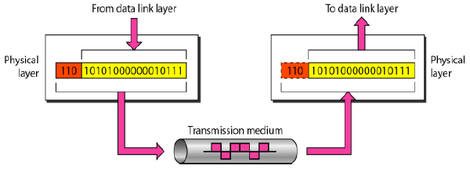
Physical Layer
Defines the connector and interface specifications as well as the medium (cable) requirements
Electrical, mechanical, functional and procedural specifications are provided for sending a bit stream on a computer network

Slide 8
Physical Layer
Physical characteristics of interfaces and medium
Representation of bits - encoding
Data rate - number of bits sent each second
Synchronization of bits - timing
Line configuration – point-to-point, multipoint
Physical topology – bus, star, ring,mesh,hybrid
Transmission mode – simplex, half-duplex, duplex

Slide 9
Some components at Layer 1
Cabling system components
Adapters that connect media to physical interfaces
Connector design and pin assignments
Hub, repeater and patch panel specifications
Wireless system components
Parallel SCSI
Network Interface Card (NIC)

Slide 10
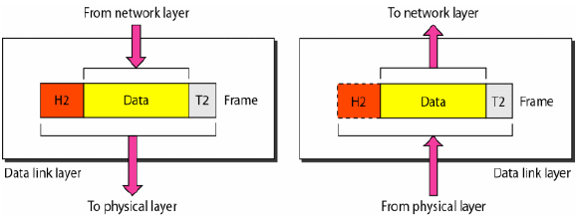
Data Link Layer
Transforms the physical layer to a reliable link
Makes the physical layer appear error-free to the upper layer

Slide 11
Data Link Layer
Framing – defining frames
Data link addressing – defines sender/receiver
Flow control – prevents overwhelming the receiver
Error control – detect and re-transmit damaged or lost frames, use of trailers
Access control – defines which device has control over the link when it is shared by devices

Slide 12
Some components at Layer 2
Ethernet and Token Ring switches
Bridges

Slide 13
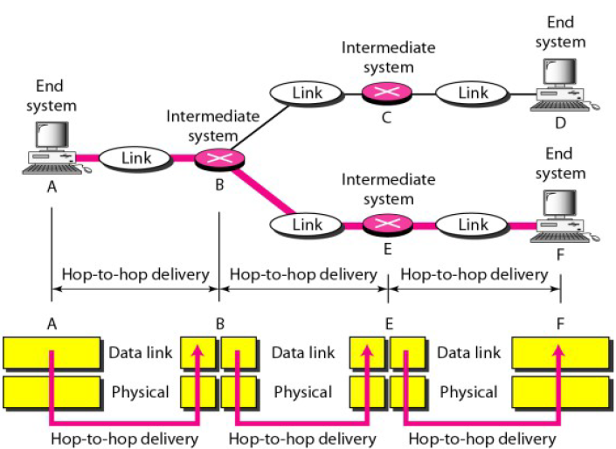
Hop to hop delivery

Slide 14
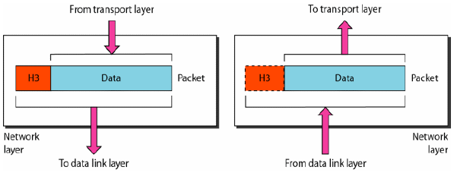
Network Layer
Source-to-destination delivery of packets, possibly across multiple networks
No need for network layer if two systems are connected to the same link

Slide 15
Network Layer
Logical addressing – distinguish source and destination systems if packets pass network boundary
Routing – makes possible the delivery of packets in internetworks, connecting devices are called routers and switches

Slide 16
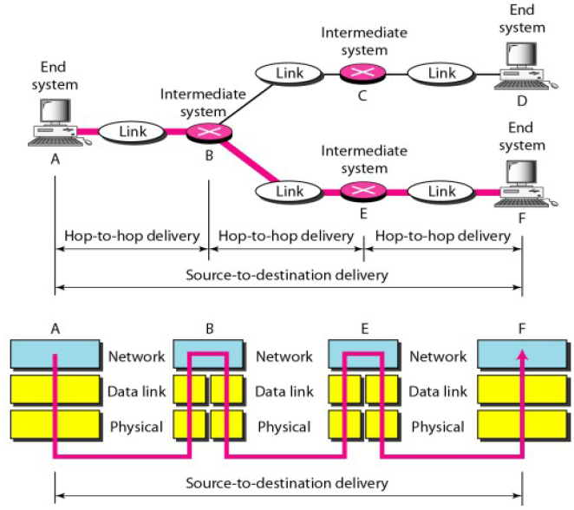
Source to destination delivery

Slide 17
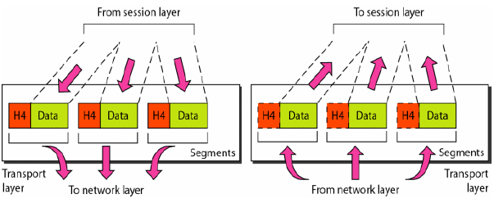
Transport Layer
Responsible for process-to-process delivery
Ensures that the whole message arrives intact and in order

Slide 18
Transport Layer
Service-point addressing – several programs (entities) can use the network, uses ports
Segmentation and reassembly – message divided into transmittable segments (uses sequence numbers)
Connection control – maybe connectionless or connection-oriented
Flow control – end-to-end flow control rather than a single link
Error control – process-to-process flow control rather than single link

Slide 19
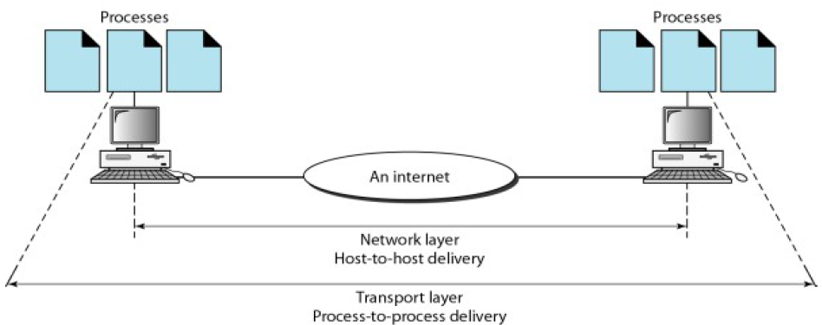
Process to process delivery

Slide 20
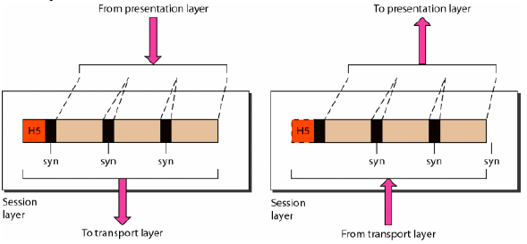
Session Layer
Network dialog controller
Establishes, maintains, and synchronizes interactions among communicating systems
Dialog control – dialog between two systems
Synchronization – add checkpoints (similar to databases)

Slide 21
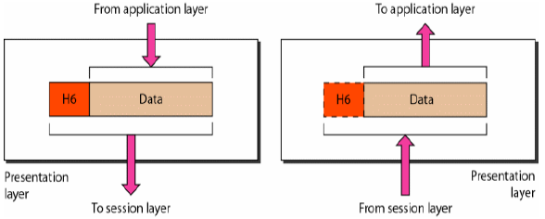
Presentation Layer
Concerned with the syntax and semantics of the information exchanged between two systems
Translation – apply encoding schemes
Encryption – provides privacy
Compression – reduce the number of bits contained in the information

Slide 22
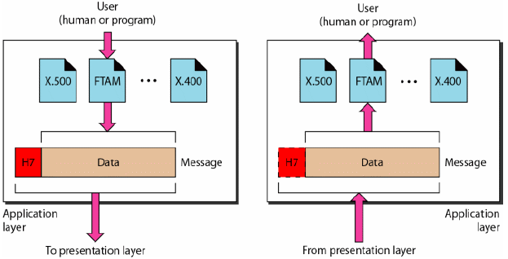
Application Layer
Enables the user (human or software) to access the network
Provides user interfaces and support services: email, remote file access and transfer, shared DBM, distributed information services

Slide 23
Application Layer
Network virtual terminal – software version of a software terminal
File transfer, access, and management – access files remotely
Mail services – email forwarding and storage
Directory services – distributed database sources

Slide 24
OSI Model Summary
Application
To allow access to network resources
To translate, encrypt, and compress data
Presentation
Session
To establish, manage, and terminate sessions
To provide reliable process-to-process message delivery and error recovery
Transport
Network
To move packets from source to destination; to provide internetworking
To organize bits into frames; to provide hop to hop delivery
Data Link
To transmit bits over a medium; to provide mechanical and electrical specification
Physical

Slide 25
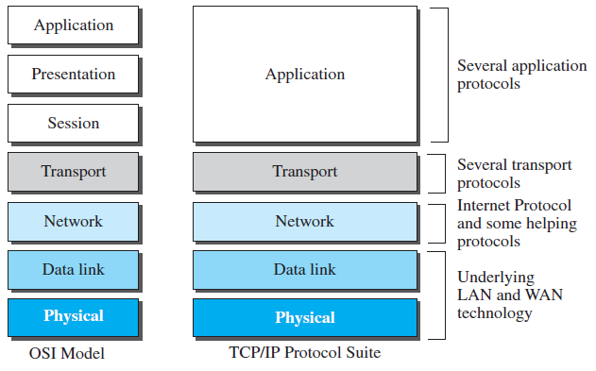
OSI vs TCP/IP

Slide 26
Lack of OSI Model’s success
TCP/IP was fully in place; changing it would cost a lot
Some layers are not fully defined
  Presentation and session layers actual protocols were not fully defined, nor fully described and corresponding software was not fully developed
When OSI was implemented by an organization in a different application, it did not show high enough level of performance to entice the Internet authority to switch

Slide 27
Lack of OSI Model’s success
Read “The Internet that wasn’t” by Andrew L. Russell
https://spectrum.ieee.org/tech-history/cyberspace/osi-the-internet-that-wasnt
https://ieeexplore.ieee.org/document/6565559

Slide 28
Reference
Forouzan, B.A. 2013. Data Communications and Networking, 5th Ed. McGraw-Hill, New York.

